Slide 1
Arduino Music Sequencer
Jenna deBoisblanc
November 3rd, 2014

Slide 2
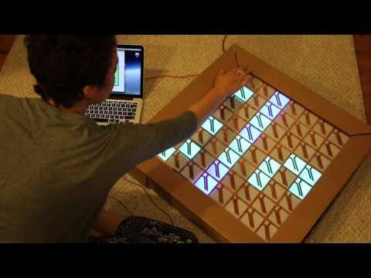

Slide 3
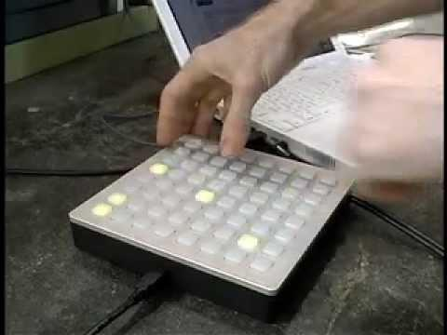

Slide 4
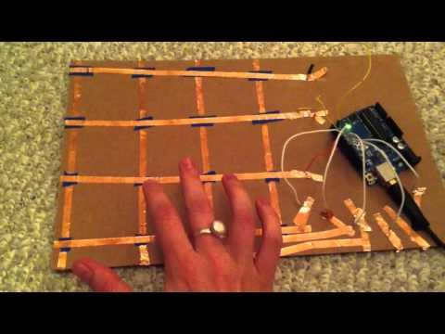

Slide 5
physical computing

Slide 6
use programming to interact with
the physical world

Slide 7
Overview
What is an Arduino?
Writing voltages
Blink
Fade
RGB LEDs
Reading voltages
photoresistor
vibration sensor
button
Neopixels
Neopixels + Processing
Monome

Slide 8
Arduino 101

Slide 9
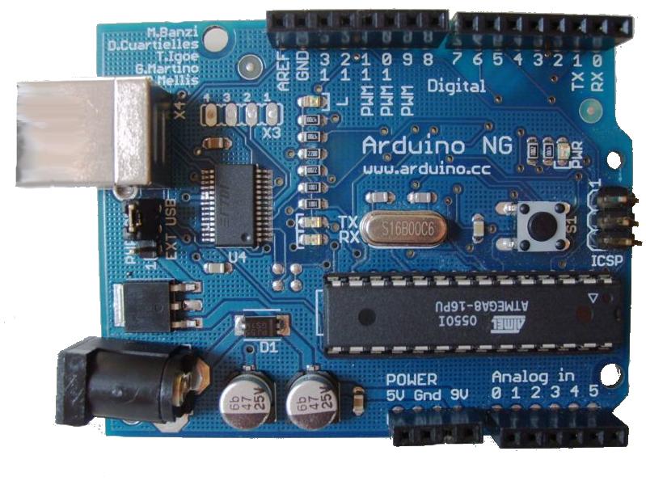
What is Arduino?
open-source hardware+software tool for building interactive electronics projects

Slide 10
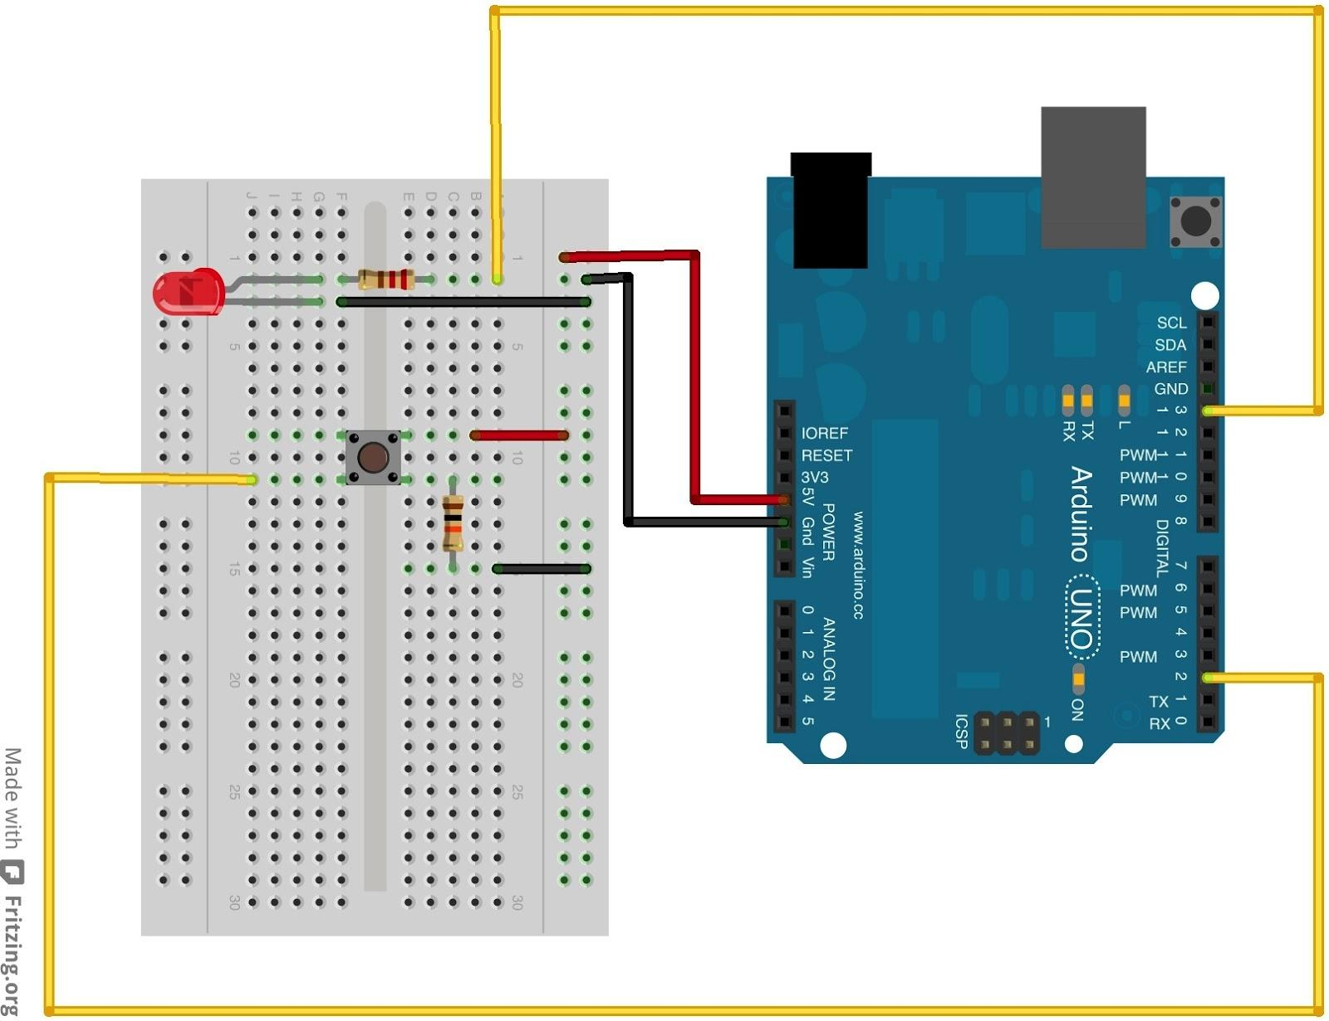
What can an Arduino do?
- write voltages (control components)
- read voltages
(sense the world)

Slide 11

Examples: Solar Sinter

Slide 12
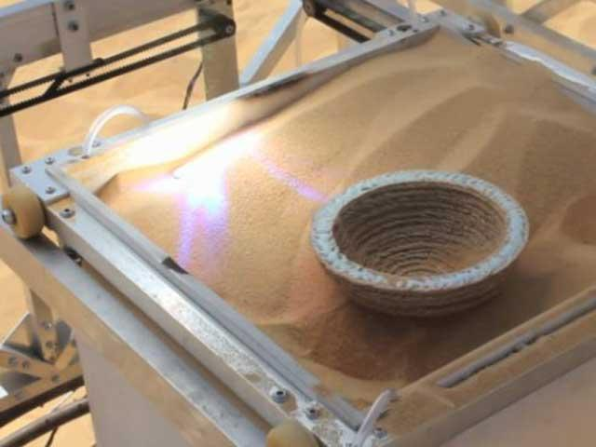
Examples: Solar Sinter

Slide 13
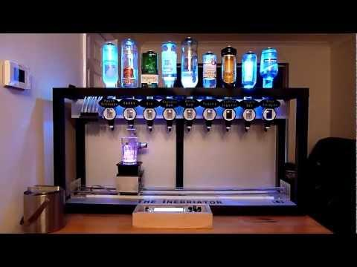
Examples: Cocktail Maker

Slide 14


Slide 15

Examples: pimpMyBike

Slide 16
Simple Circuit

Slide 17
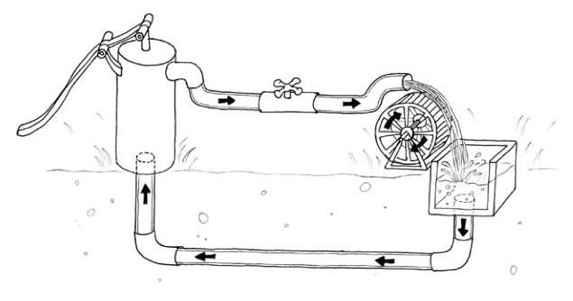
circuit water analogy
Resistance
(R)
Voltage
(V)
<- Current (I)

Slide 18
resistor calculator
What value are the resistors?
http://www.digikey.com/en/resources/conversion-calculators/conversion-calculator-resistor-color-code-4-band

Slide 19
Writing Voltages
(making things move, light up, beep, etc.)

Slide 20
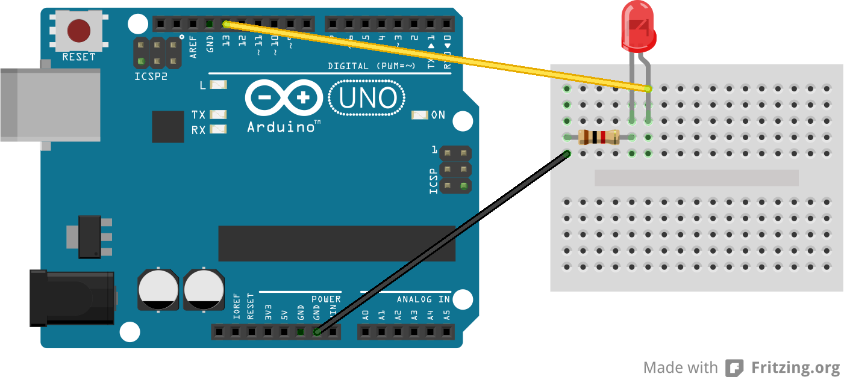
Blink
file > examples > basic > blink

Slide 21
Blink
can you make the LED blink faster?
slower?

Slide 22
Fading
file > examples > analog > fading

Slide 23
Fade
What do you need to change about your circuit to make this sketch work?
What function makes the LED “fade” rather than “blink”?

Slide 24
Writing Functions
digitalWrite(pinNum, HIGH)
digitalWrite(pinNum, LOW)
---------------
analogWrite(pinNum, value)
where value is 0-255

Slide 25
Blinking ½ as bright
What do we need to change about the original Blink sketch to make the LED blink half as bright?
(hint: 2 changes)

Slide 26
Reading Voltages
(reading sensors: light, sound, temperature, ...)

Slide 27
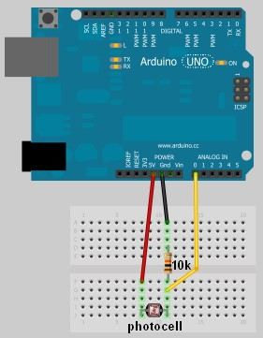
Photoresistor Circuit

Slide 28
e3_Photoresistor
// define a pin for Photoresistor
int lightPin = 0; void setup() {
// Begin serial communication Serial.begin(9600); } void loop() {
// Write the value of the photoresistor to the serial monitor.
int reading = analogRead(lightPin); Serial.println(reading); }

Slide 29
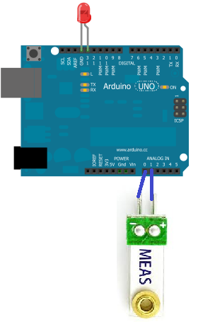
Vibration Sensor Circuit

Slide 30
e4_Vibration
int GroundPin= 0;
int sensePin= 1;
void setup() {
Serial.begin(9600);
pinMode(GroundPin, OUTPUT);
digitalWrite(GroundPin, LOW);
}
void loop() {
int reading = analogRead(sensePin);
Serial.println(reading);
}

Slide 31
Vibration Sensor Code
Can we make an LED light up when the vibration sensor value is >500?
(hint: use an “if statement”)
file > examples > control > ifStatementConditional

Slide 32
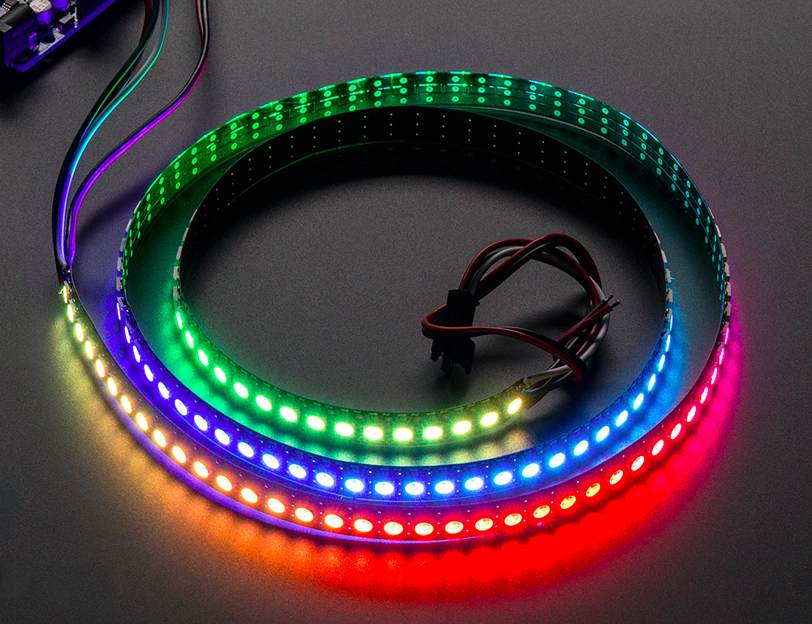
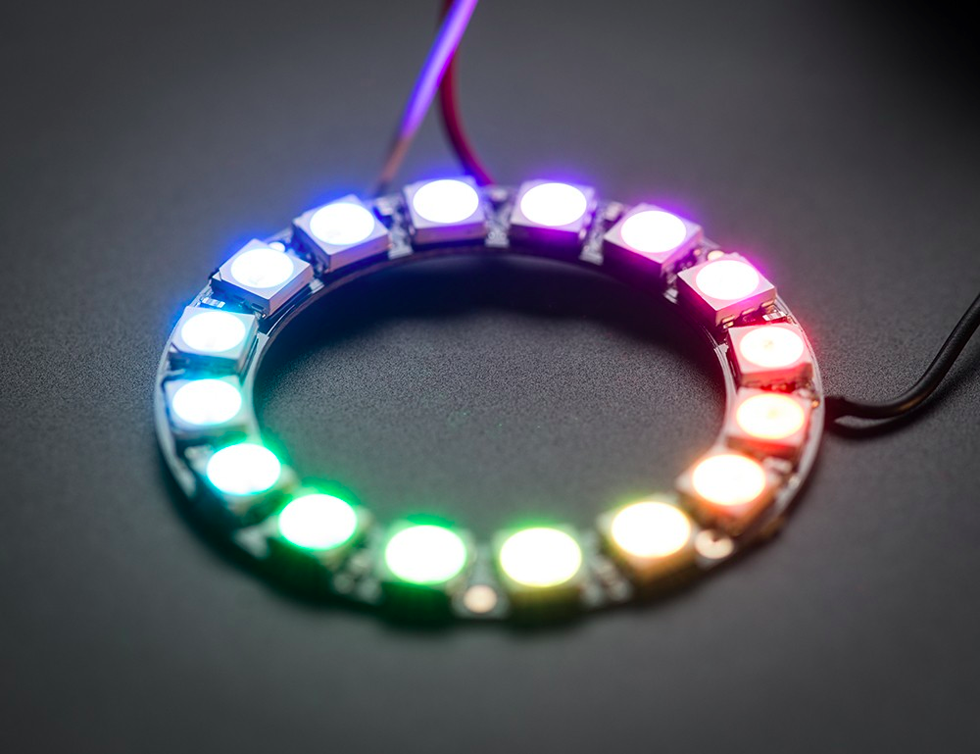
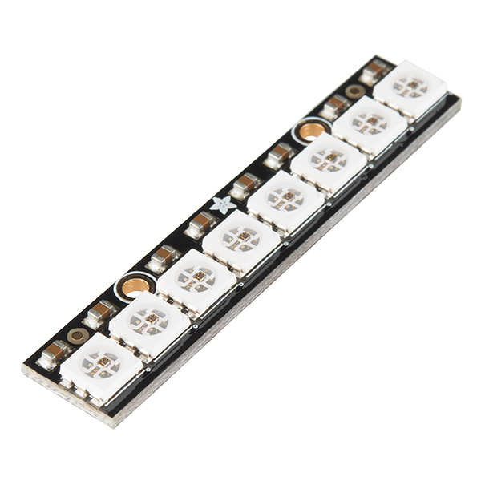
Neopixels

Slide 33
Neopixels
What is a Neopixel?
What is a library?

Slide 34
Neopixel Library
Install Neopixel library & follow instructions
Move Adafruit_Neopixel to your libraries folder:
(home) > Documents > Arduino > Libraries

Slide 35
Strandtest
File > Examples > Adafruit_Neopixel > strandtest

Slide 36
e5_Neopixel
#include <Adafruit_NeoPixel.h>
#define PIN 2
Adafruit_NeoPixel strip = Adafruit_NeoPixel(5, PIN, NEO_GRB + NEO_KHZ800);
void setup() {
strip.begin();
strip.show();
}
void loop() {
//functions go here
strip.setPixelColor(0, 255, 0, 0);
strip.show();
}

Slide 37
Useful Neopixel Functions
strip.begin()
call once in the setup
strip.show()
call everytime you want to refresh LEDs after pin colors have been set
strip.setPixelColor(pinNumber, redValue, greenValue, blueValue)
color values are 0 to 255
strip.setBrightness(brightnessValue)
brightness is between 0 (off) and 255 (brightest)

Slide 38
Neopixel Challenges
Make all of the LEDs Red
Make all of the LEDs Blue
Make the LEDs blink

Slide 39
Processing

Slide 40
Visual Programming Language
Check out the example files!
file > examples

Slide 41
Processing -> Arduino
Let’s make an LED blink when we click the screen.
e6_Processing2Arduino
> e6_ArduinoLED uploaded on Arduino
> e6_Processing opened in Processing

Slide 42
Arduino -> Processing
Let’s send “Hello World from the Arduino to Processing and print it out on the screen.
e7_Arduino2Processing
> e7_Arduino uploaded to the Arduino
> e7_Processing opening in Processing

Slide 43
Monome

Slide 44
The Copper Tape Grid
Lay 4 columns of copper tape (or however many columns you'd like to use; make sure to adjust the code accordingly)
Lay clear tape over the columns everywhere that the columns will intersect with rows (rows and columns need to be electrically isolated)
Attach a jumper to each row and each column of copper tape (I just used copper tape to make the connection) and to the Arduino
Stick an LED in pin #13 on the Arduino.

Slide 45
Code
open the Processing sketch:
monome > Processing_monome > Processing_monome.pde
upload the Arduino sketch:
monome > Arduino_monome > Arduino_monome.ino

Slide 46
Reference to Print
https://docs.google.com/document/d/1zHNrneXw_lgOzAdX9bI1PRr01ygrF1xn1JoUD-iburM/edit?usp=sharing

